Slide 1

TITLE
Participants
Dr Lara Ainley
Ms Katy Breakwell
Ms Jennalee Clark
Dr Tory Clarke
Ms Michelle Demers
Dr Siobhan Dennison
Dr James Lawson
Dr Renée Marchin
Dr Steve Van Sluyter
Ms Leslie Ward
Prof Mark Westoby
Acknowledgements
Dr Mike Aspinwall, Profs Belinda Medlyn and David Tissue, Hawkesbury Institute for the Environment
Mr Chris Hodgkins, Sciex
Dr Adam Carroll, ANU
Dr Ben Crossett, University of Sydney
Funding
SIEF John Stocker Postdoctoral Fellowship
ARC Discovery Project

Slide 2
Banter:
I saw a TED talk the other night and this guy had the audience eating out of his hand. Learned a trick or two from his act. You gotta get audience participation first and then you can hit them with the complicated scientific stuff.
Ok let me try this. Please raise your hand if you live with a dog. (yeah, that’s a good one! Everyone likes talking about their dog… alright, cool – good number of you on board with me here.)
Right – so now keep your hands up, if your dog breathes air. Oh, apologies to those of you whose dogs no longer breathe air, sorry, poor taste maybe. Well, maybe I’m missing out the people who don’t have dogs. How bout everyone who breathes air themselves, raise your hand. Come on, don’t be shy. If you breathe air, raise your hand. Good! Then maybe you have something to learn today.

Slide 3
Photosynthesis is important.
Pics of: banded ironstone formations in the Pilbara
The Amazon
Earth from space
Diagram of a terrestrial biosphere model

Slide 4
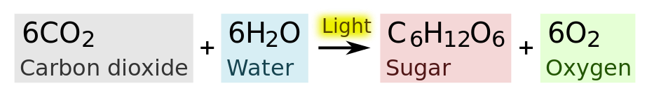
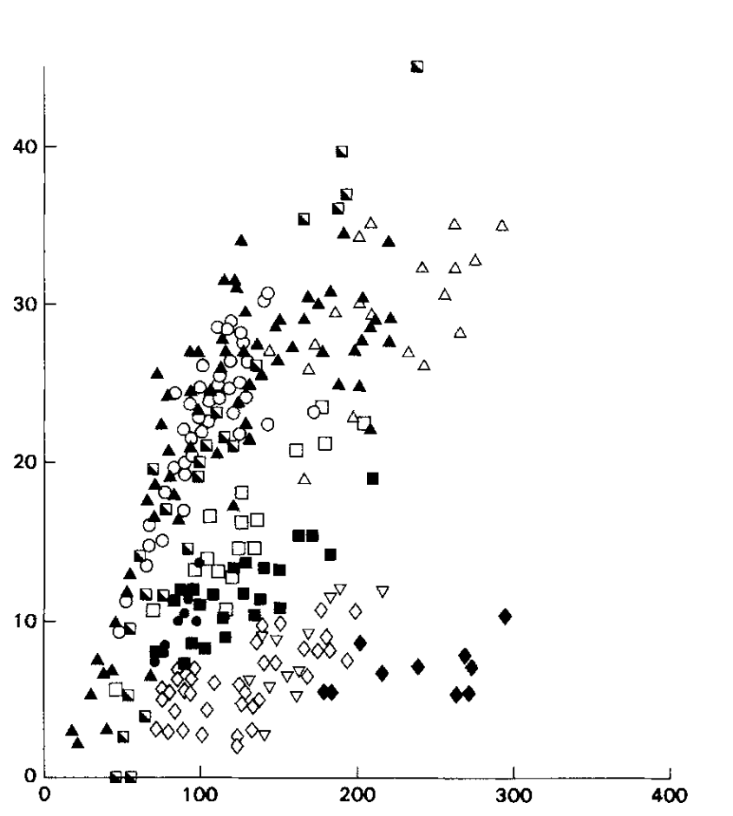
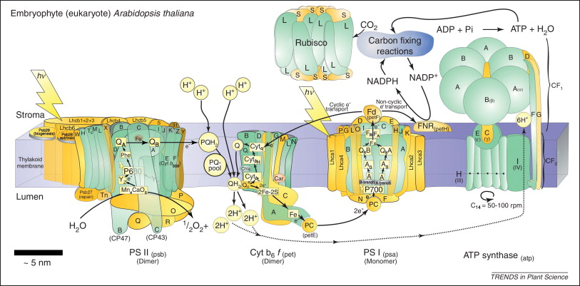
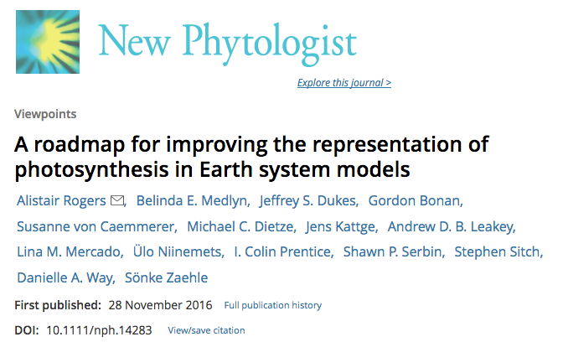
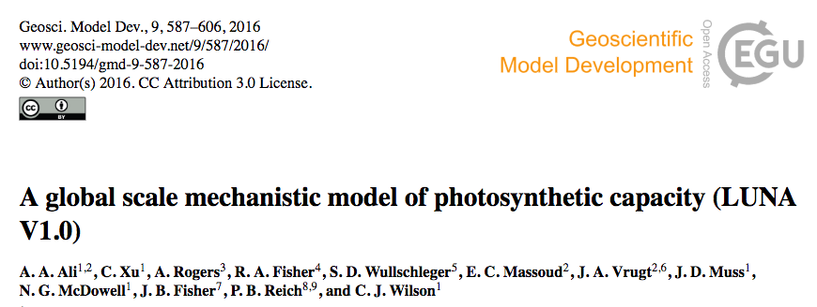
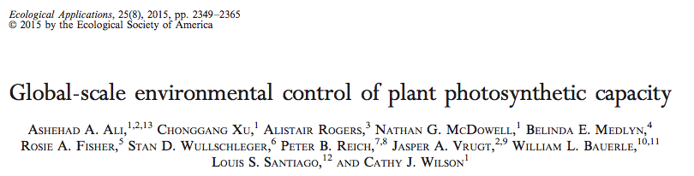
Photosynthetic capacity
Leaf N
Allen et al 2011 Trends Plant Sci
Evans 1989 Oecologia
Notes:
We have a pretty good understanding of the biochemistry of photosynthesis, but to estimate the actual capacity of wild plants to perform this reaction, we tend to rely on relatively simple, cheap methods such as measuring leaf nitrogen content. Leaf N content provides a reasonable estimate of photosynthetic capacity, since most N in a cell is in protein, and most protein in leaves is doing photosynthesis. But as you can see there’s a huge amount of scatter in this relationship.
Some recent terrestrial biosphere models have placed emphasis on modelling allocation of N resources to different functions within the photosynthetic apparatus, so as to better describe the relationship between leaf N and photosynthetic capacity. These models typically just estimate enzyme amounts. In the quantitative proteomics project I’m going to talk about we can put actual numbers on these enzyme amounts.
We haven’t gotten as far as incorporating our data into larger systems of models, and I won’t pretend to properly understand the nitty gritty of these papers. But I’d like to introduce the project to you and show the first set of results that have come out of it.
Most N in a cell is protein. Proteins, not RNA, catalyze nearly all reactions in a cell. Changes in abundance of metabolic enzymes reflect changes in metabolism.
RNA is a much looser approximation of metabolic changes because protein amounts are dictated by translation rates and protein half-lives, both of which can’t be derived from RNA data.
N allocation strategies can be derived from proteomics because the most abundant proteins are identified.

Slide 5
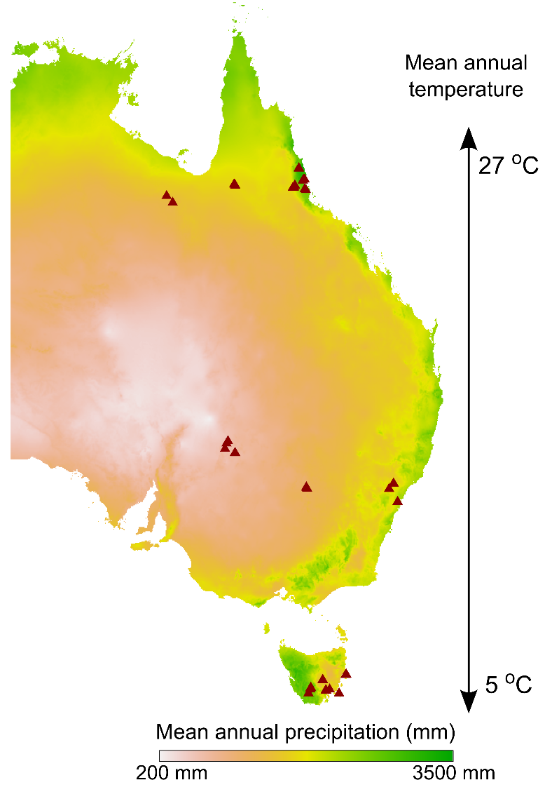
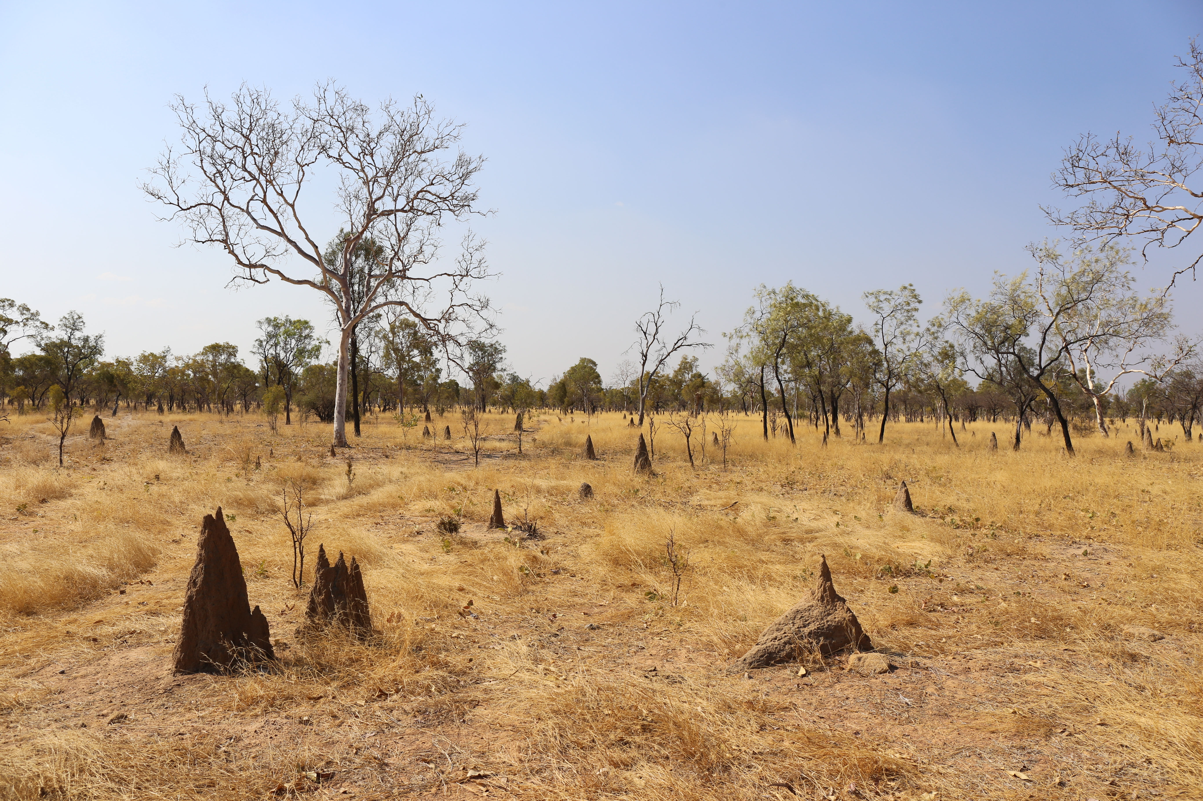
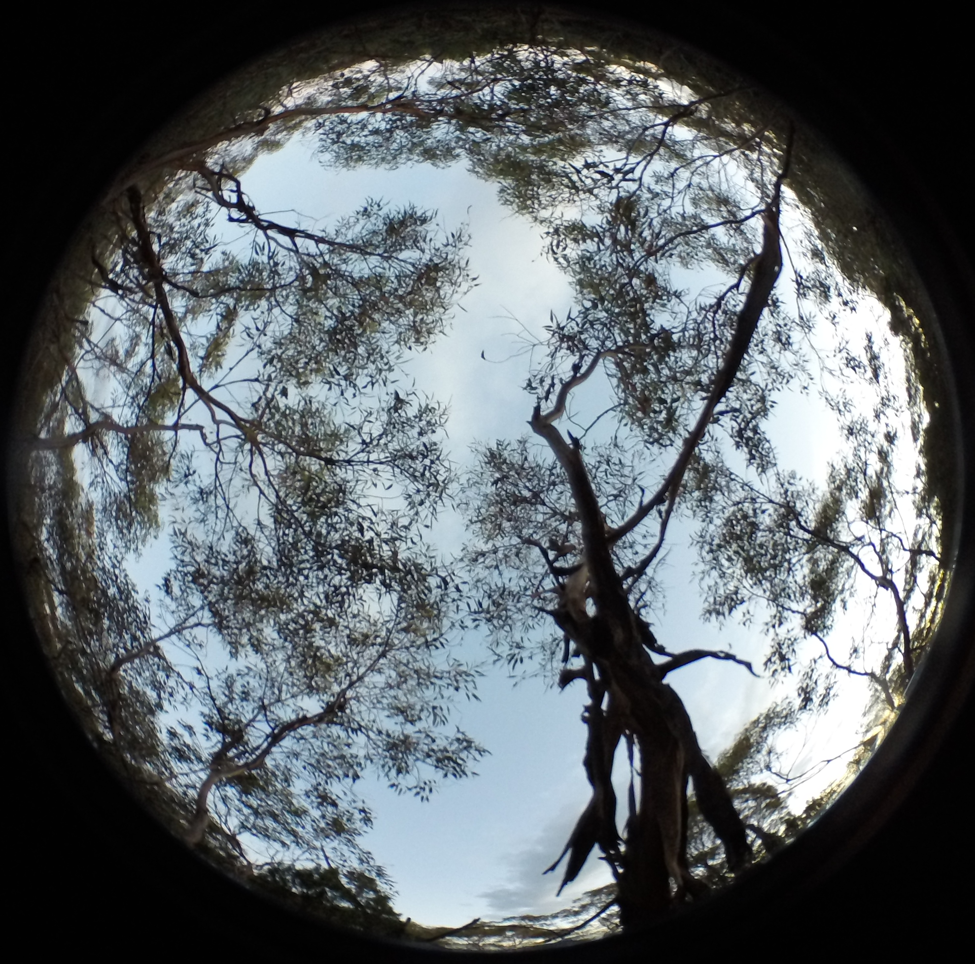
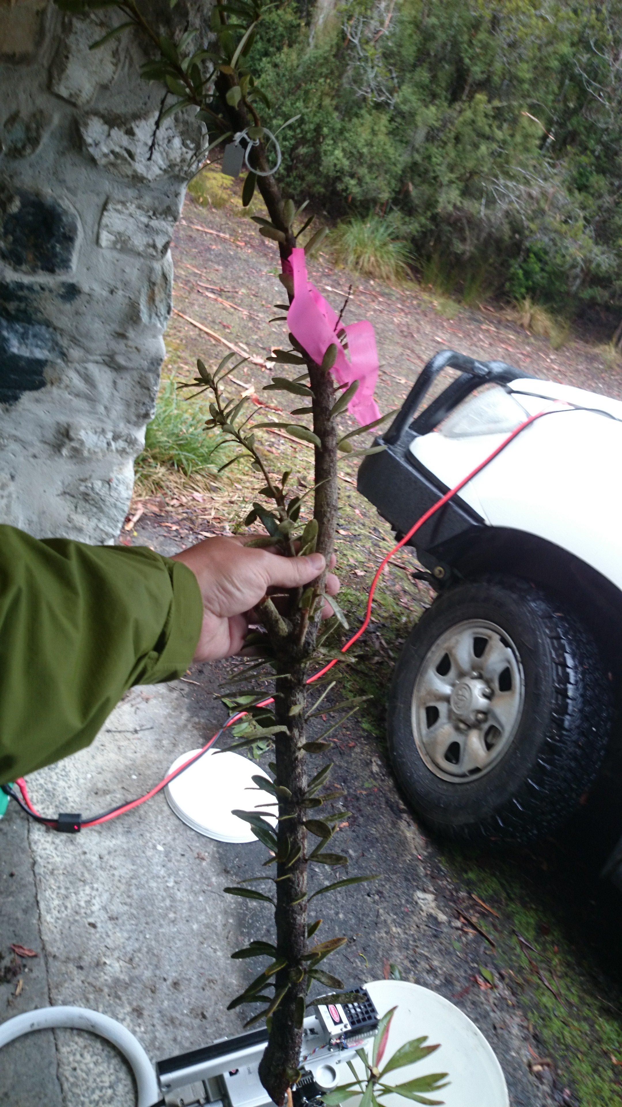
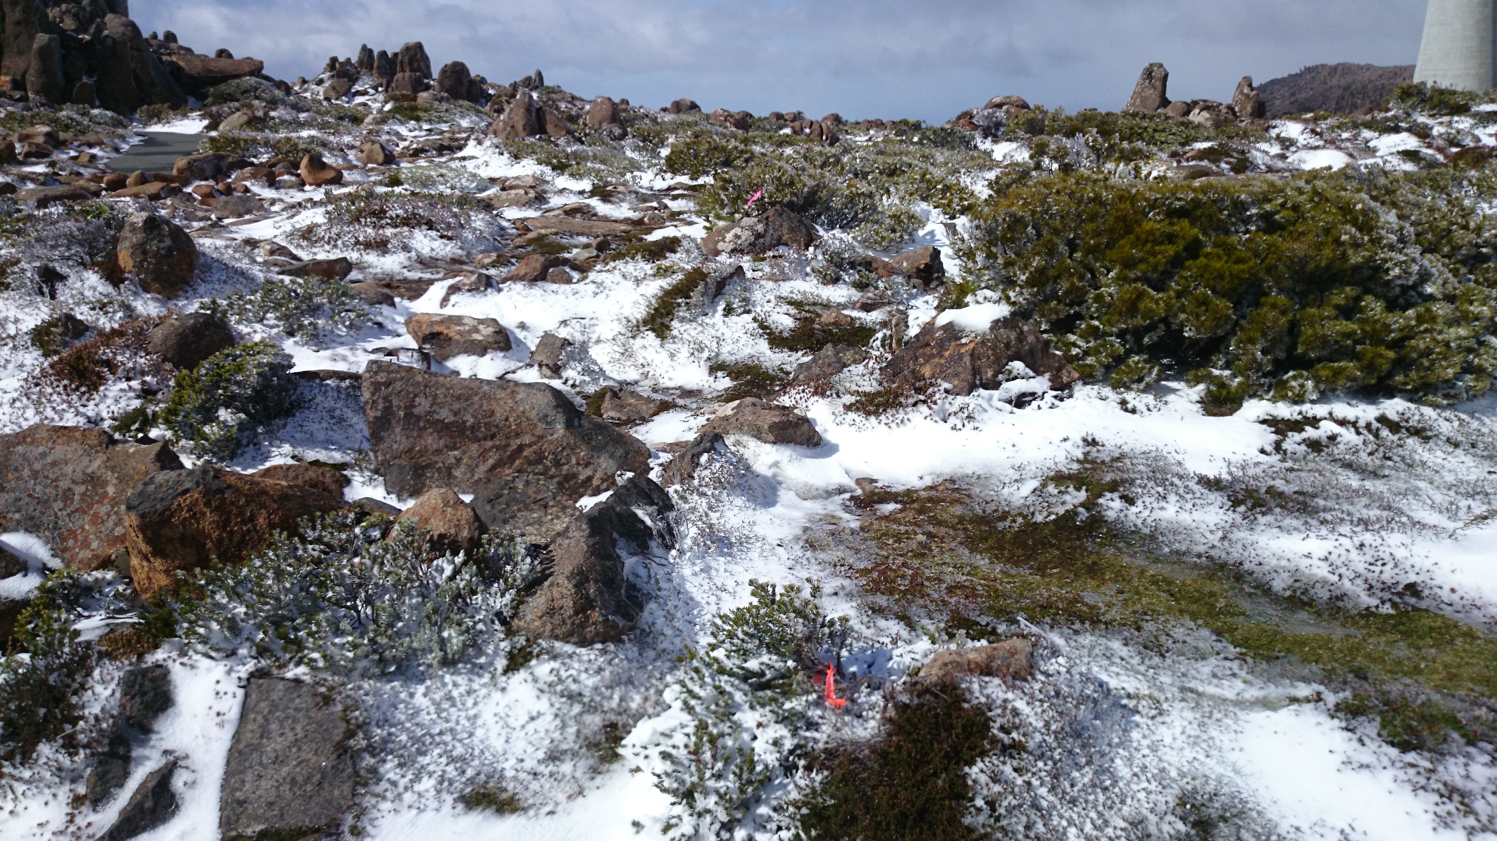
102 species: 32 eucalypts, 27 Acacia, 43 Proteaceae
>4000 samples; 1100 for proteomics
3 plants per species * site
3 leaf ages per plant + senescent leaves
Notes:
Emphasise continental scale. This is a really really massive study.

Slide 6
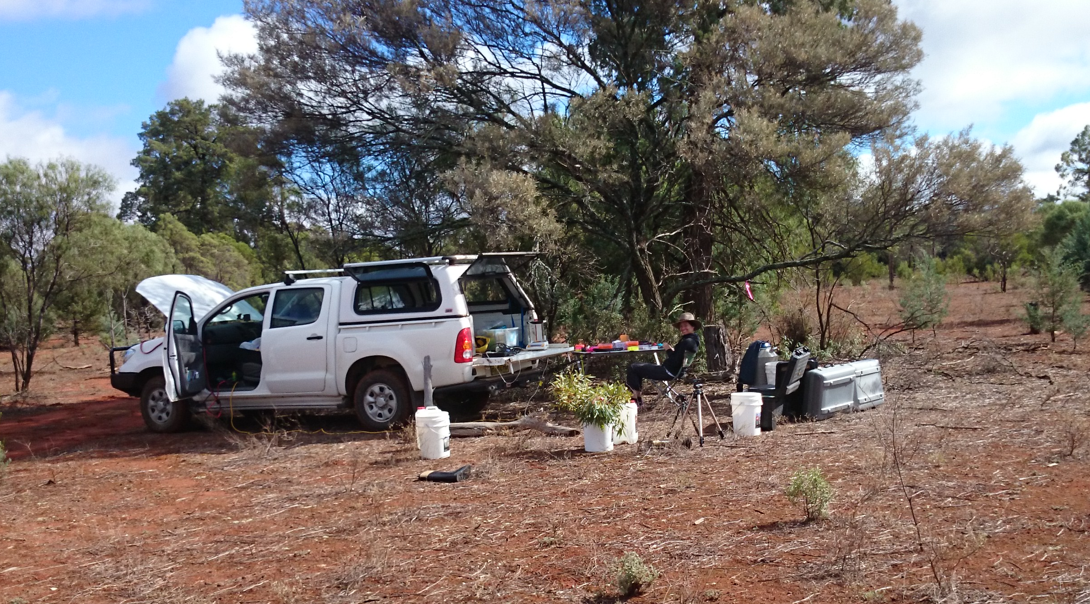
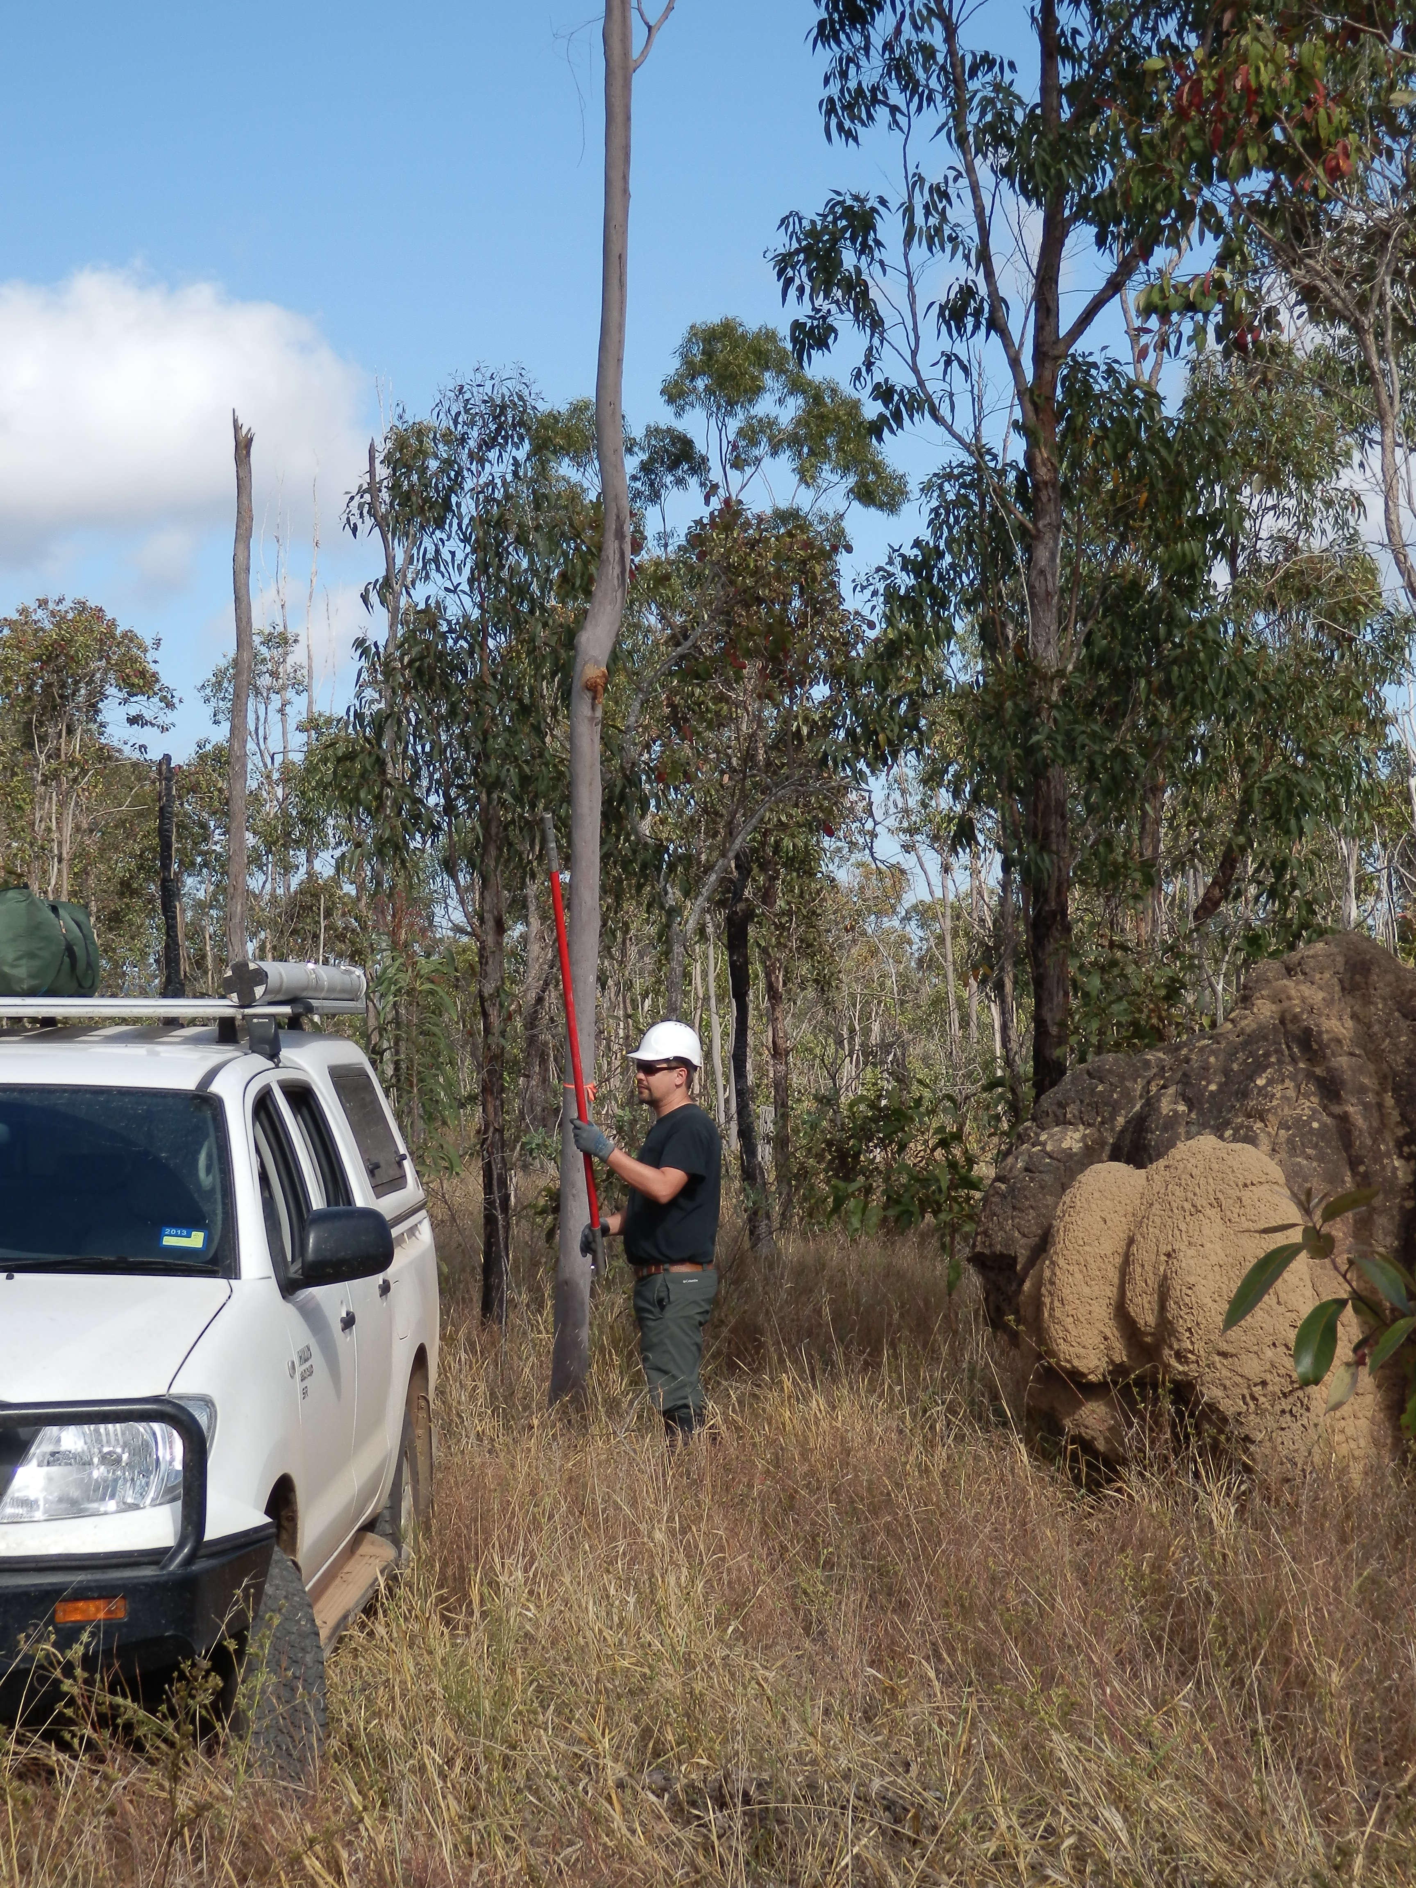
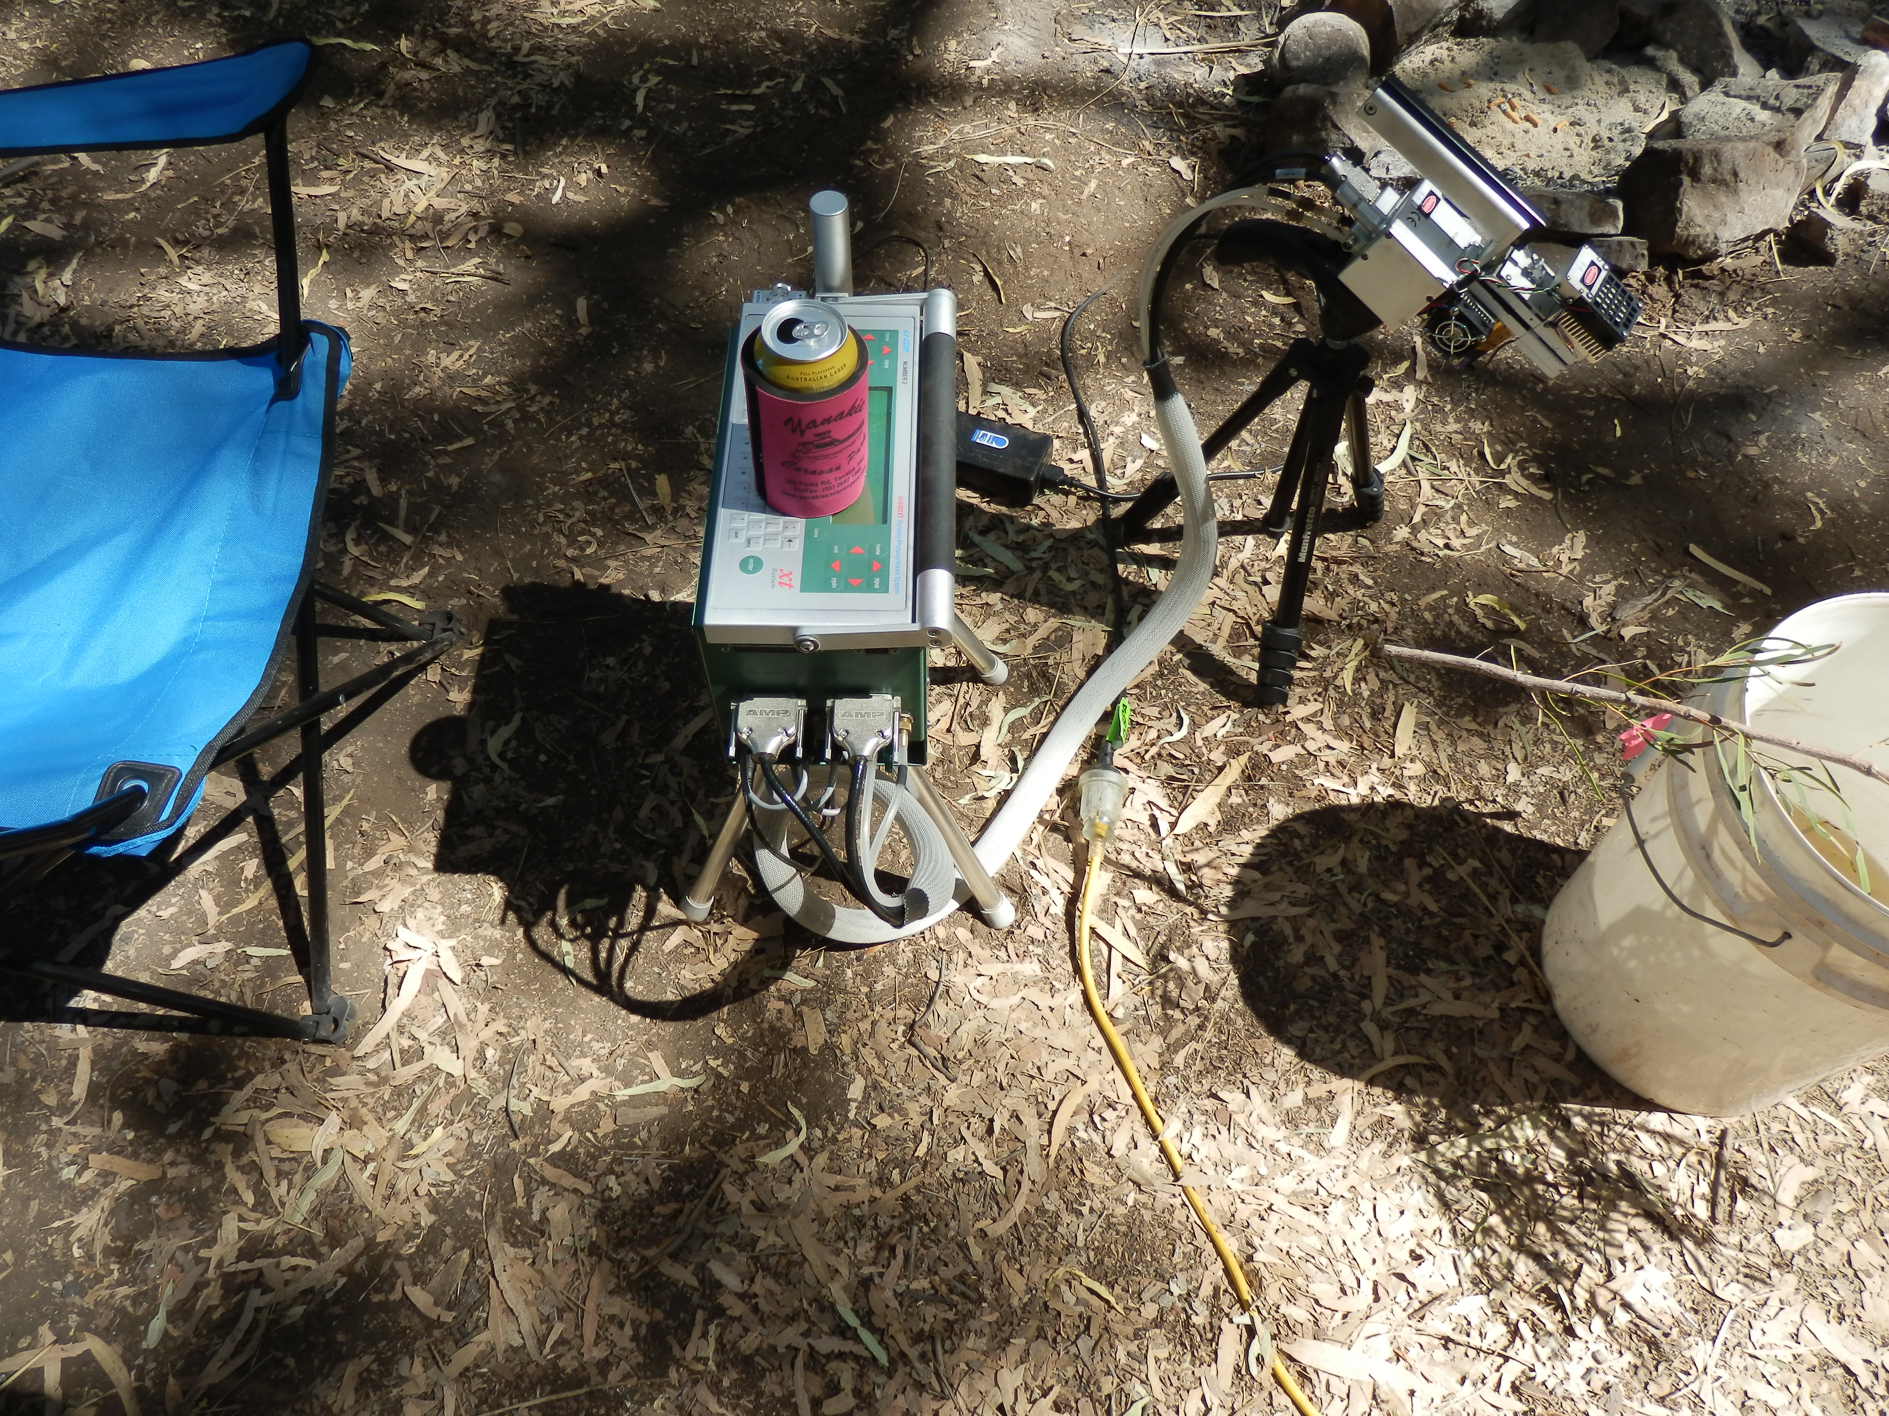
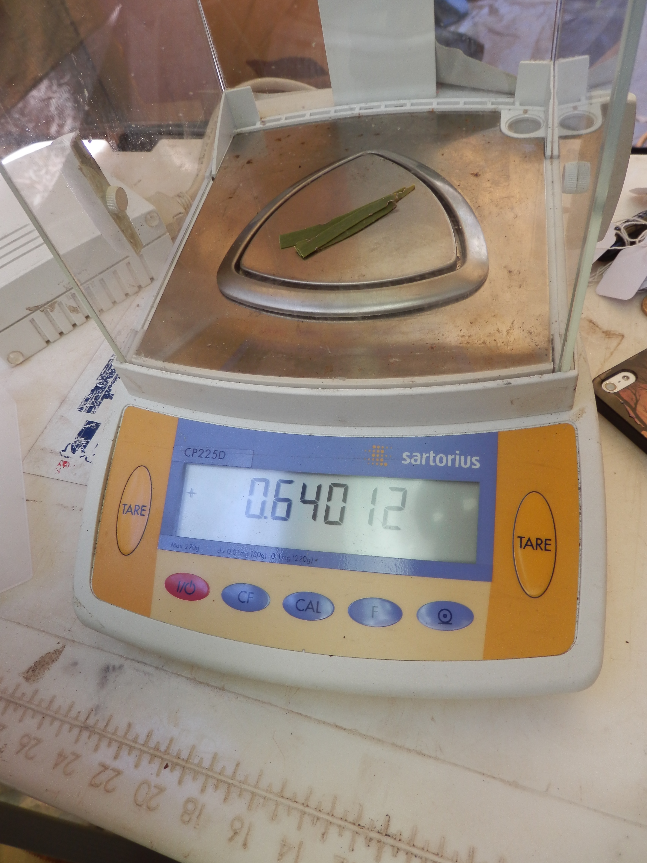
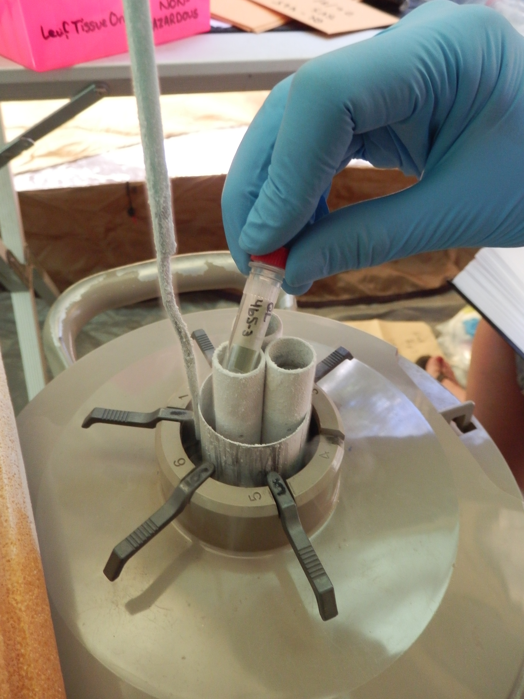
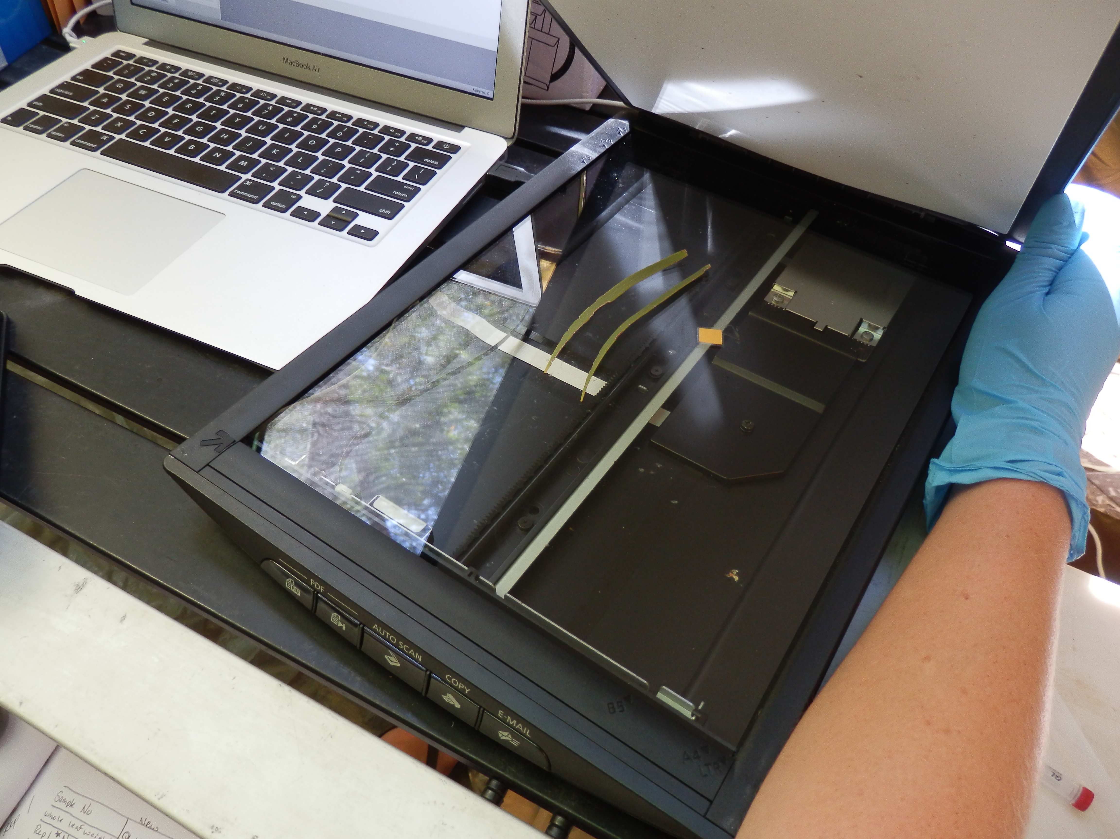
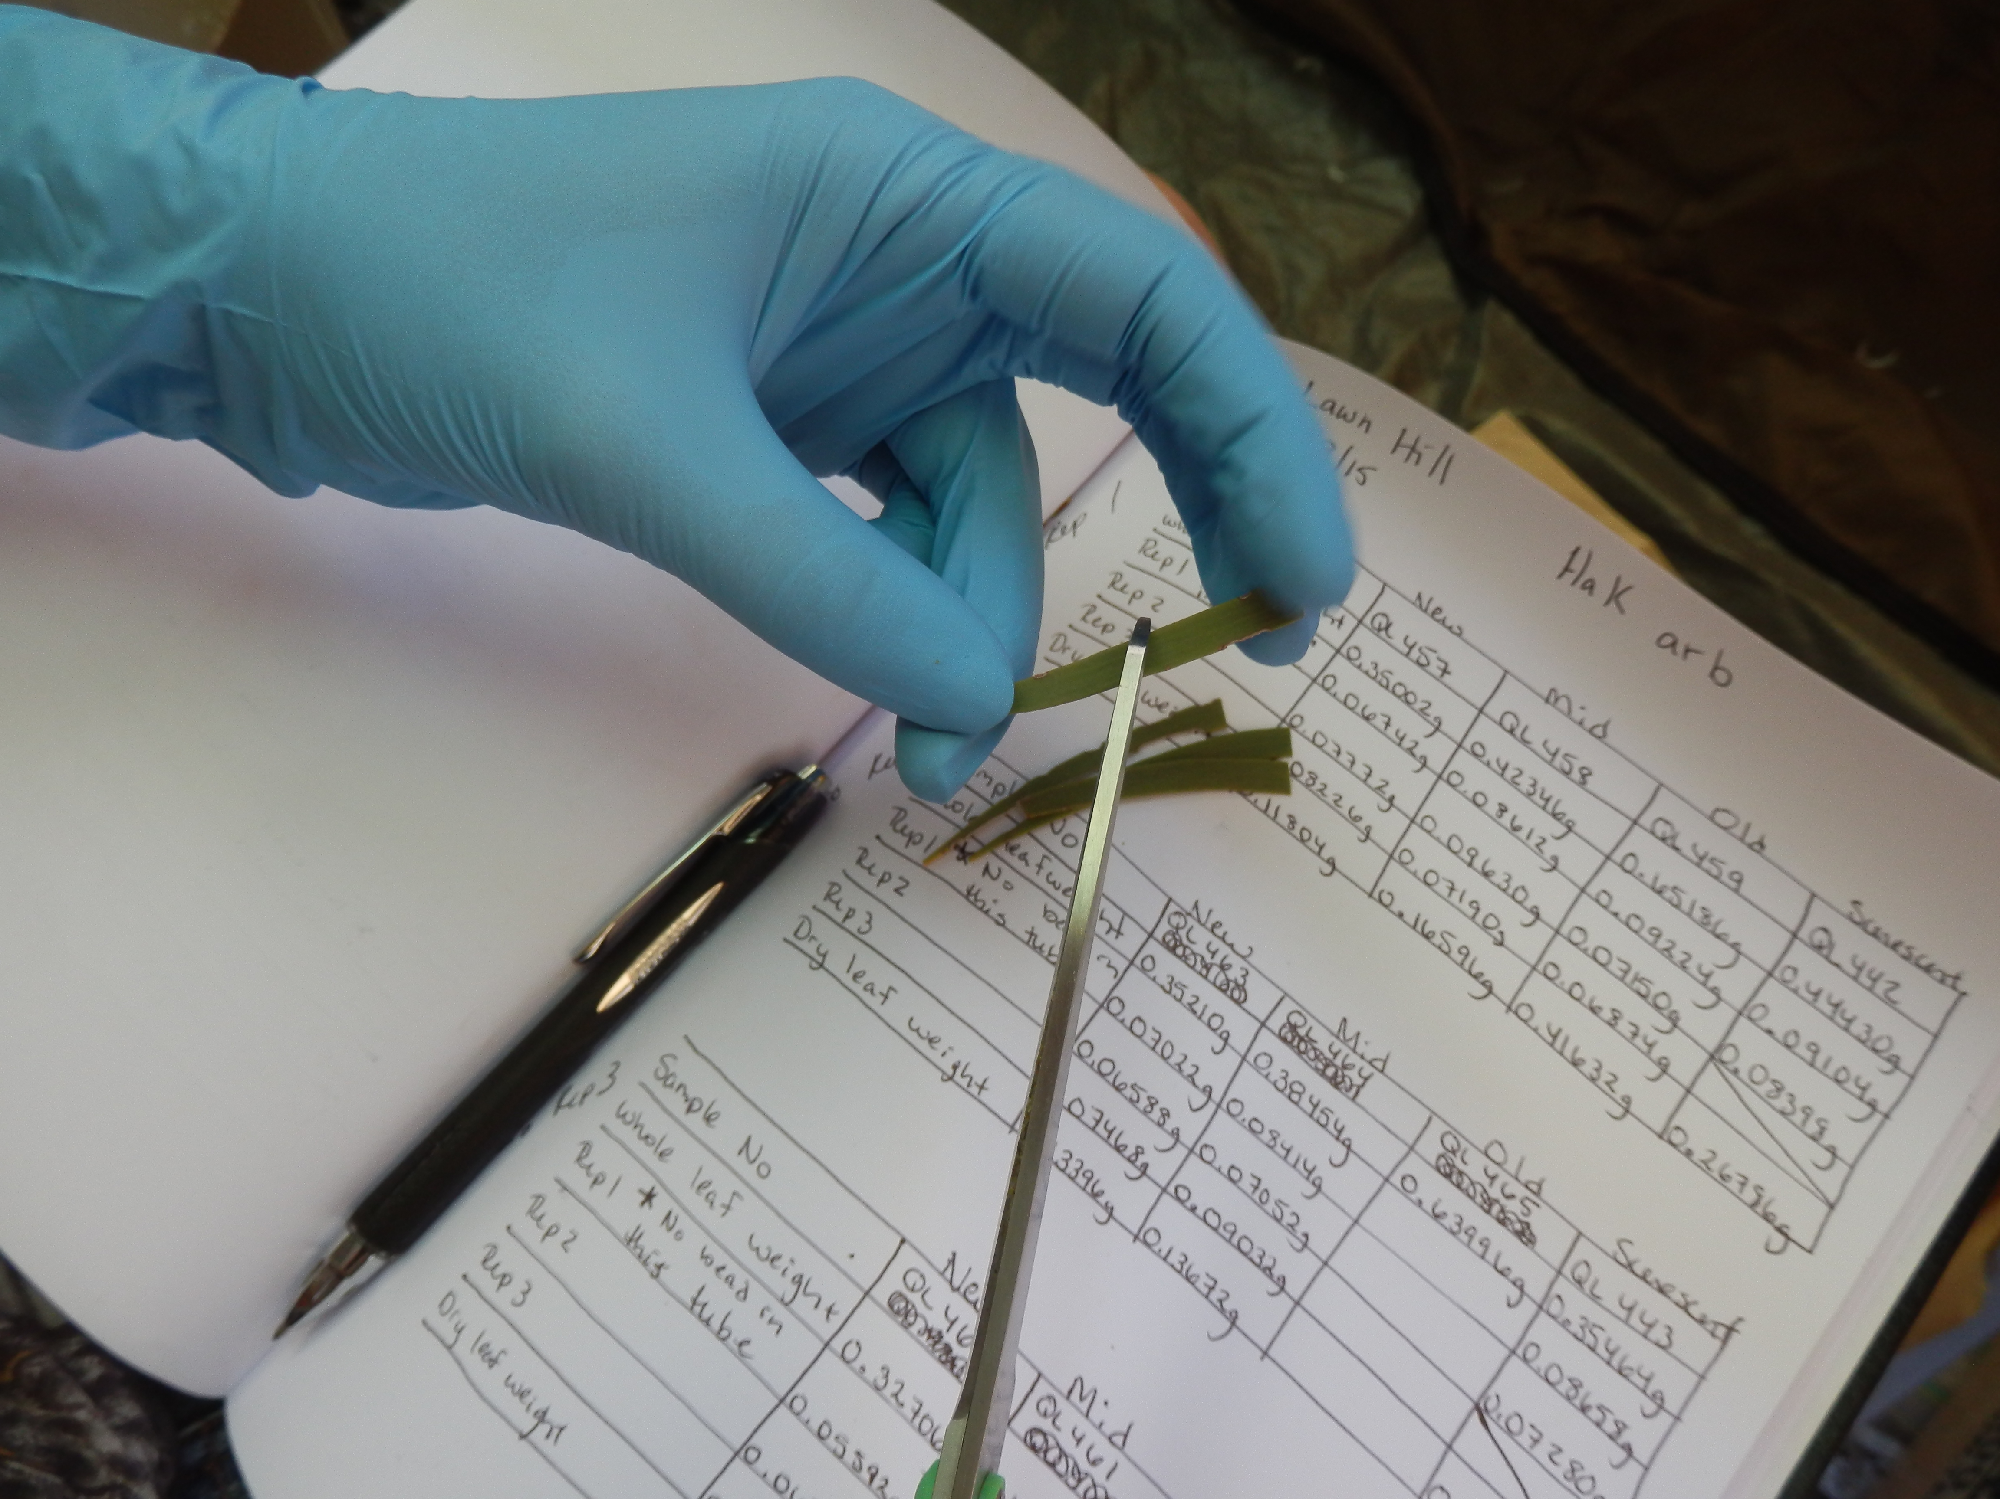

Slide 7
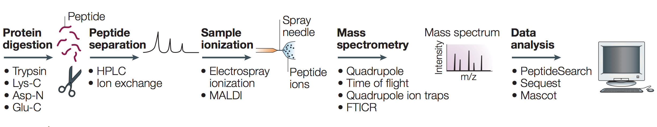
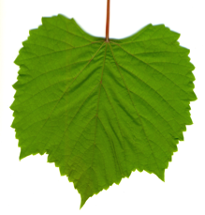
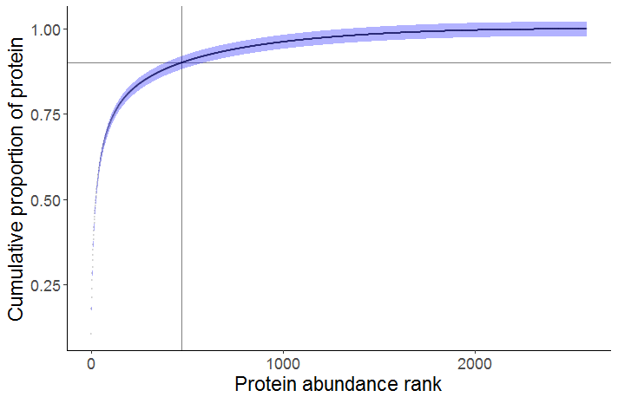
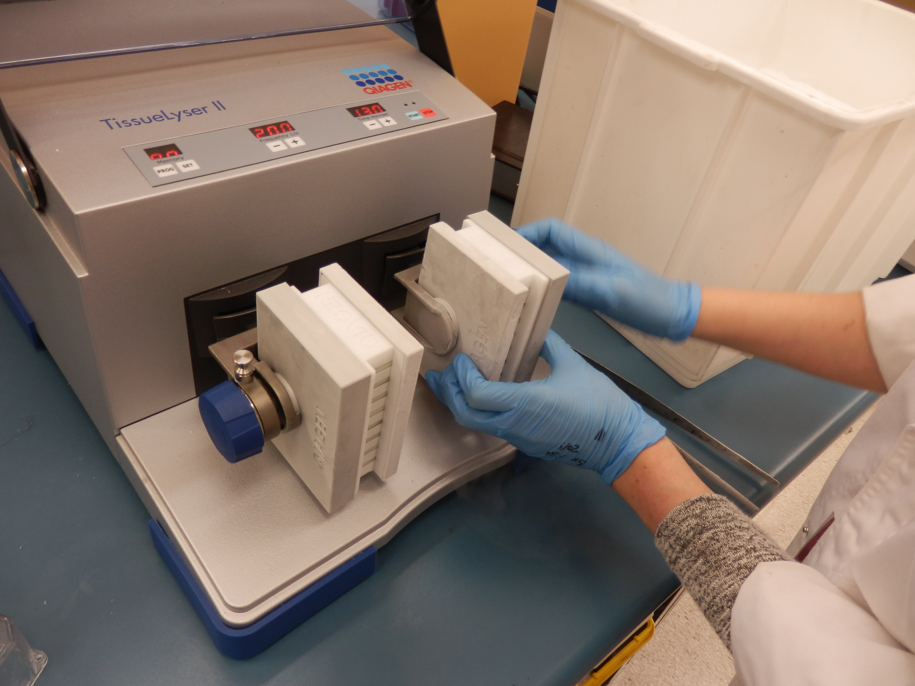
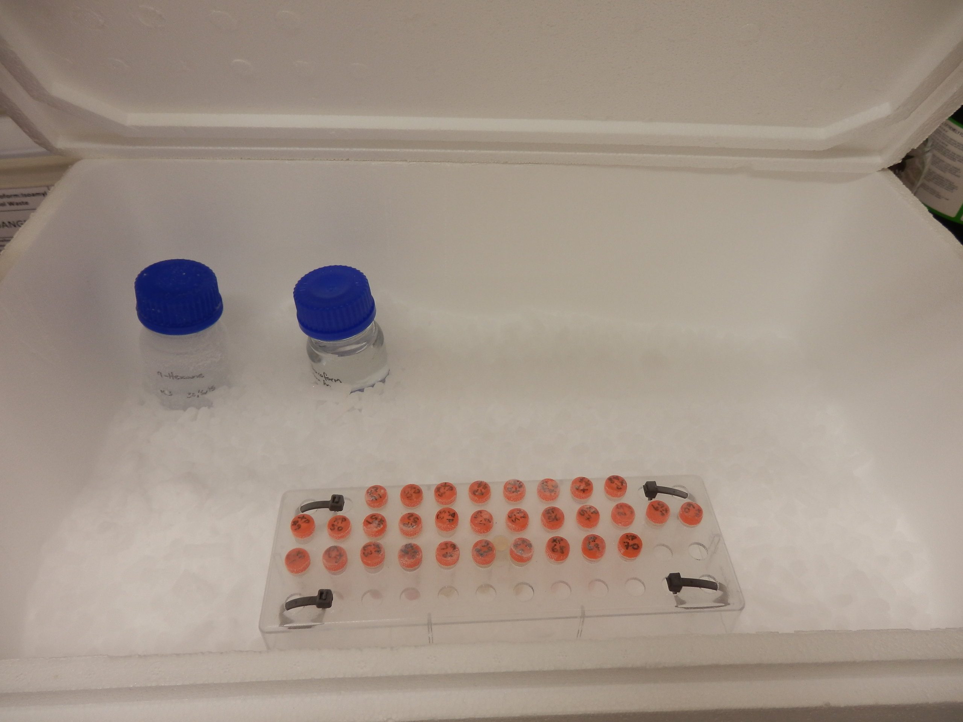
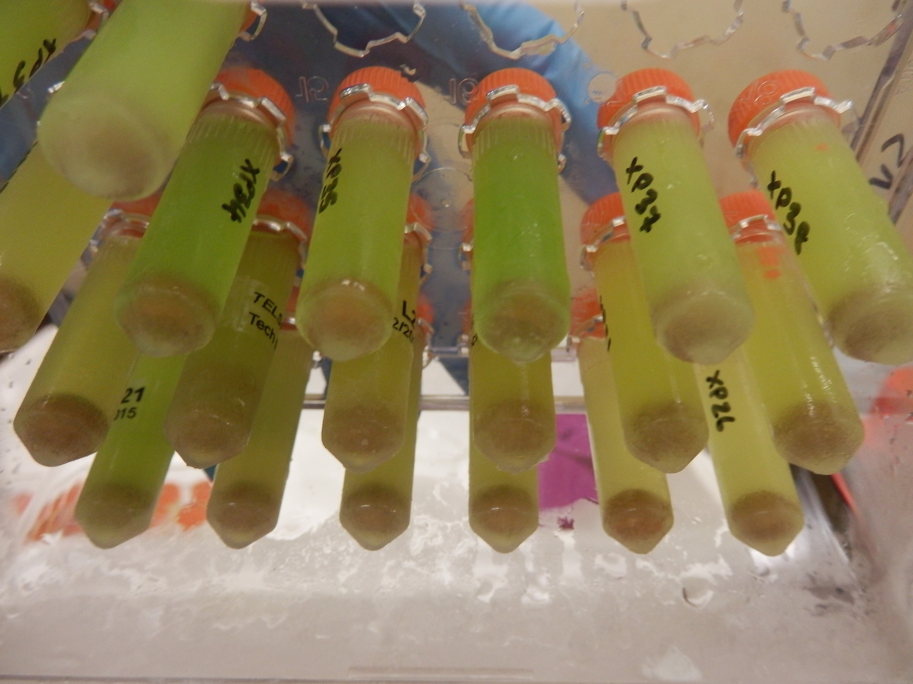
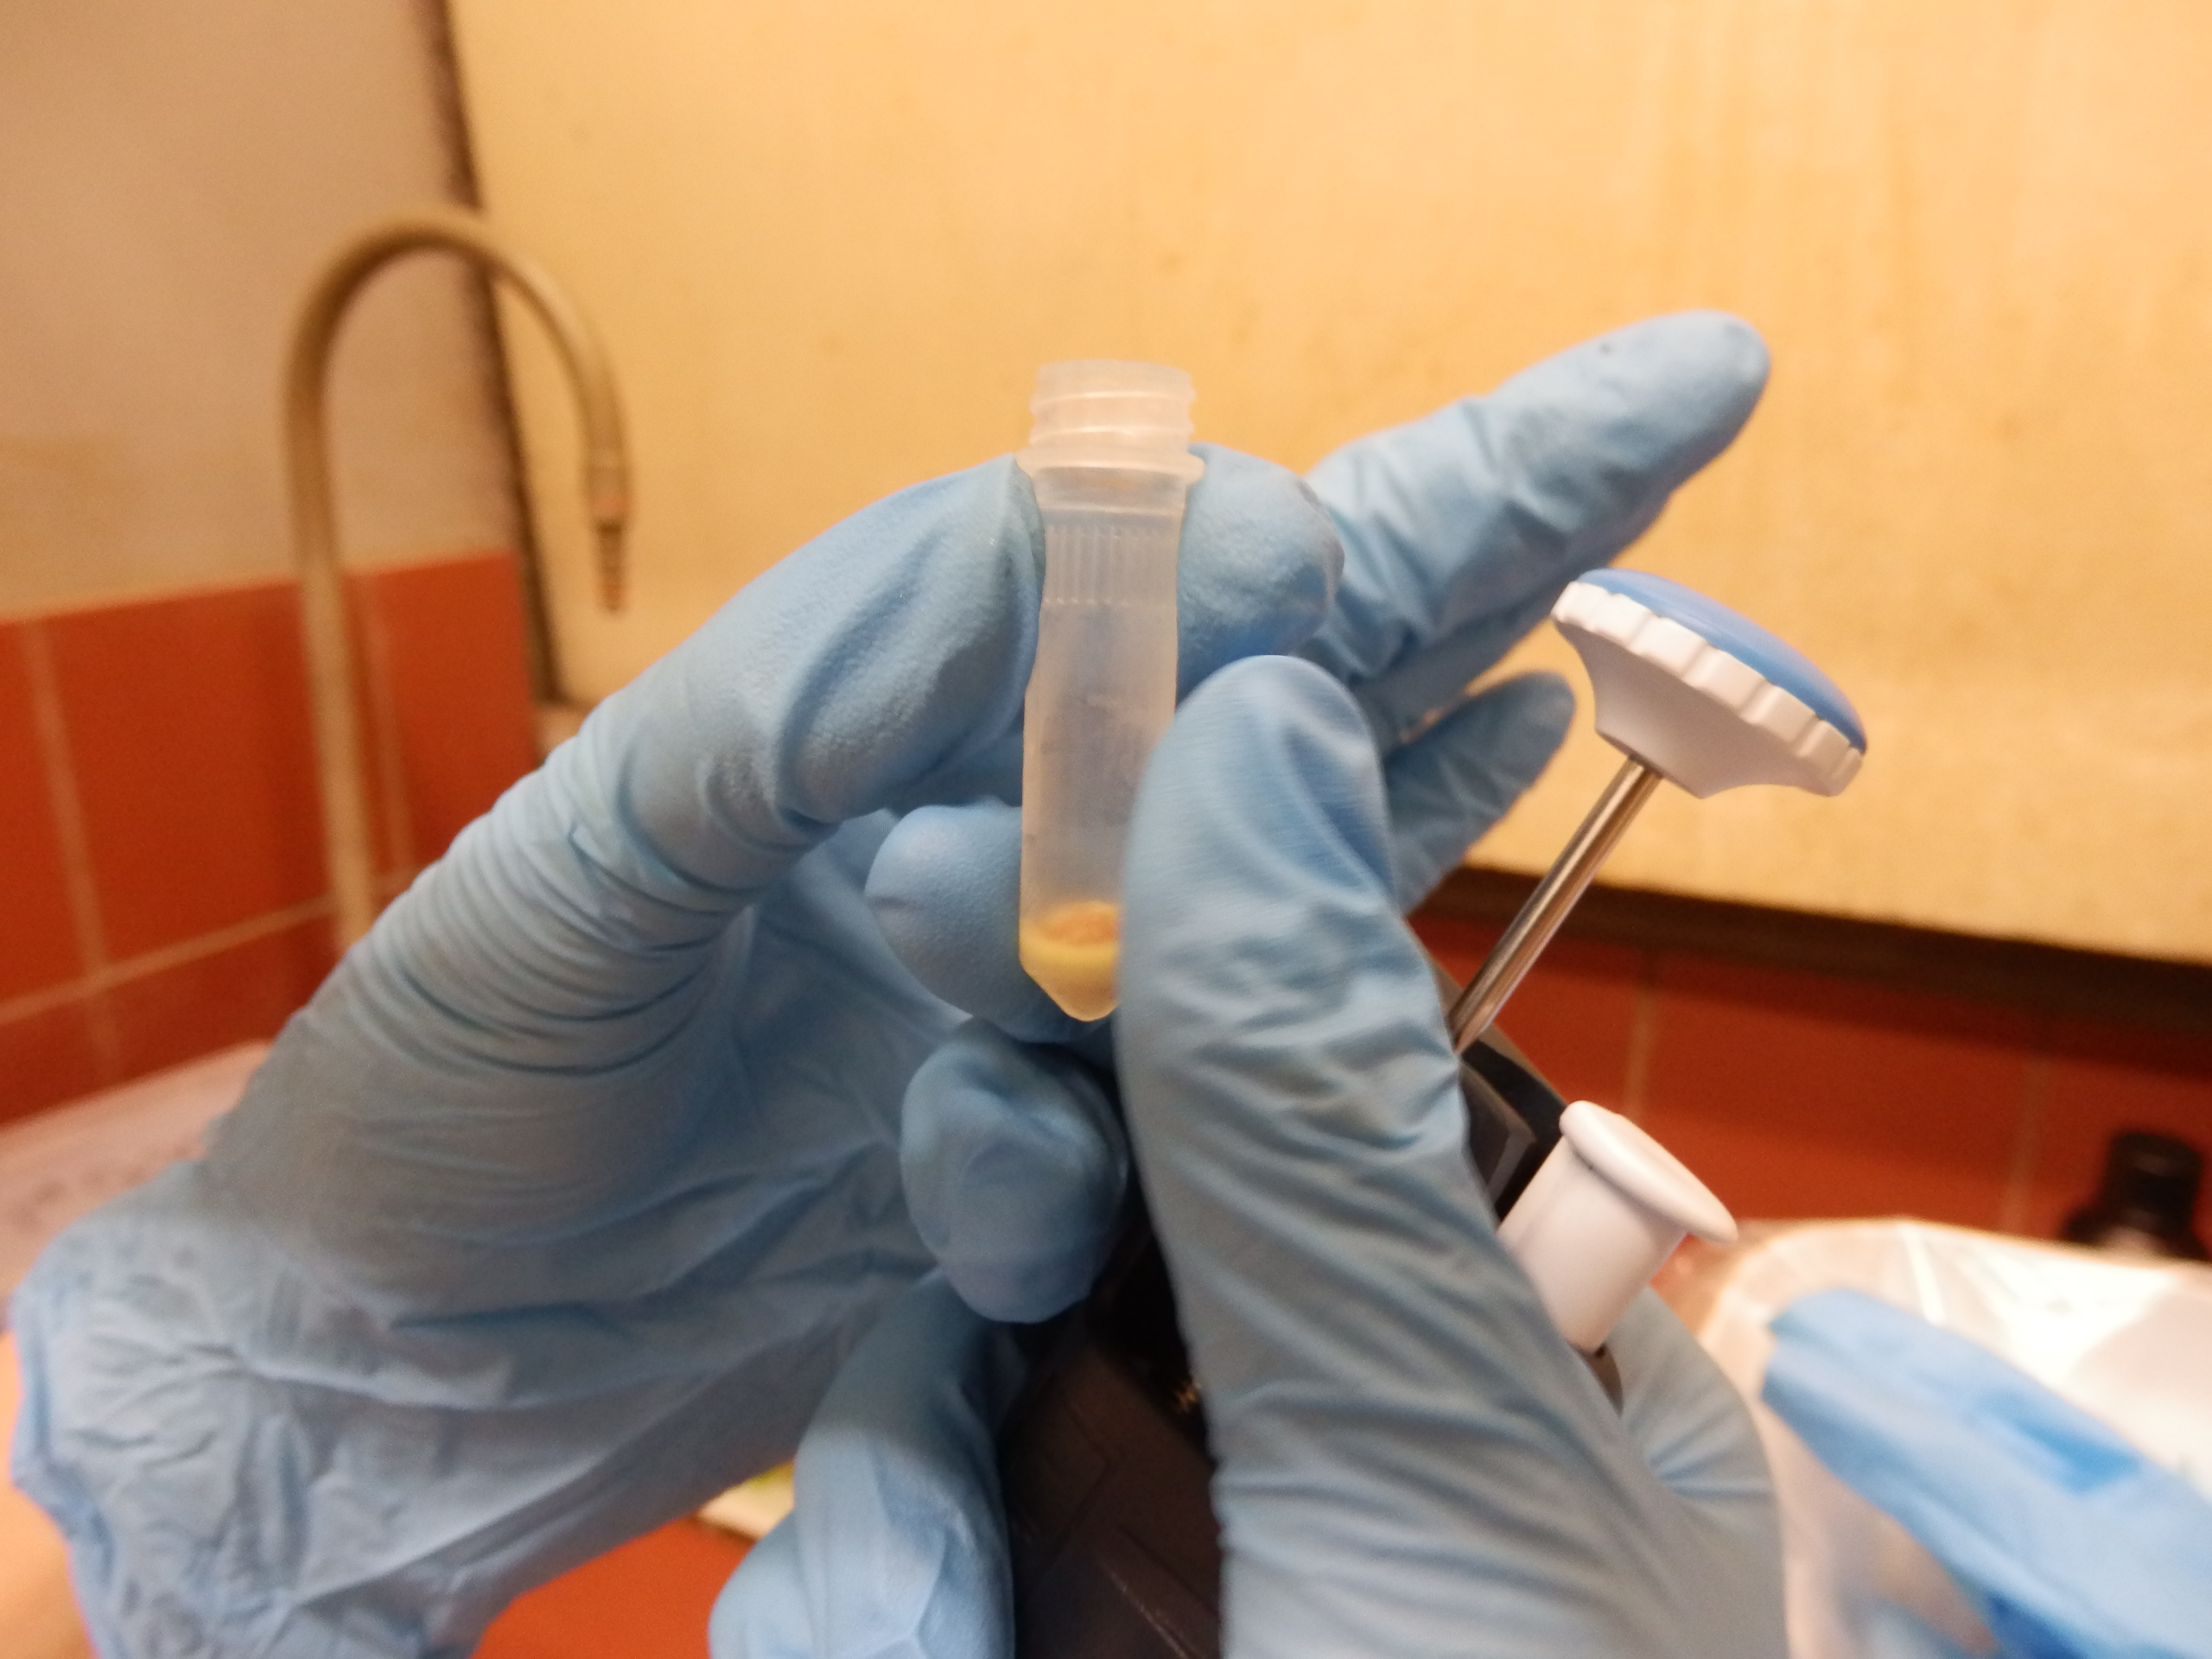
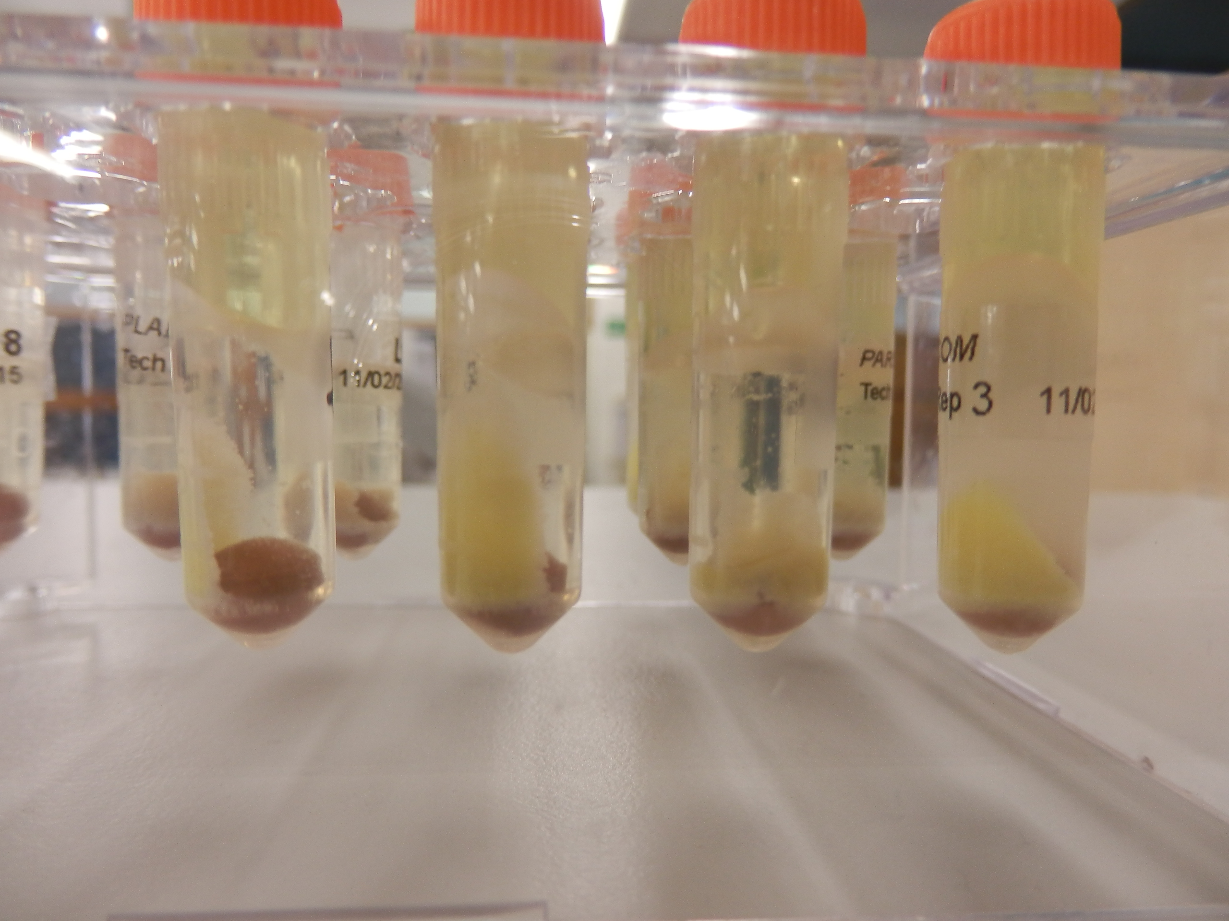
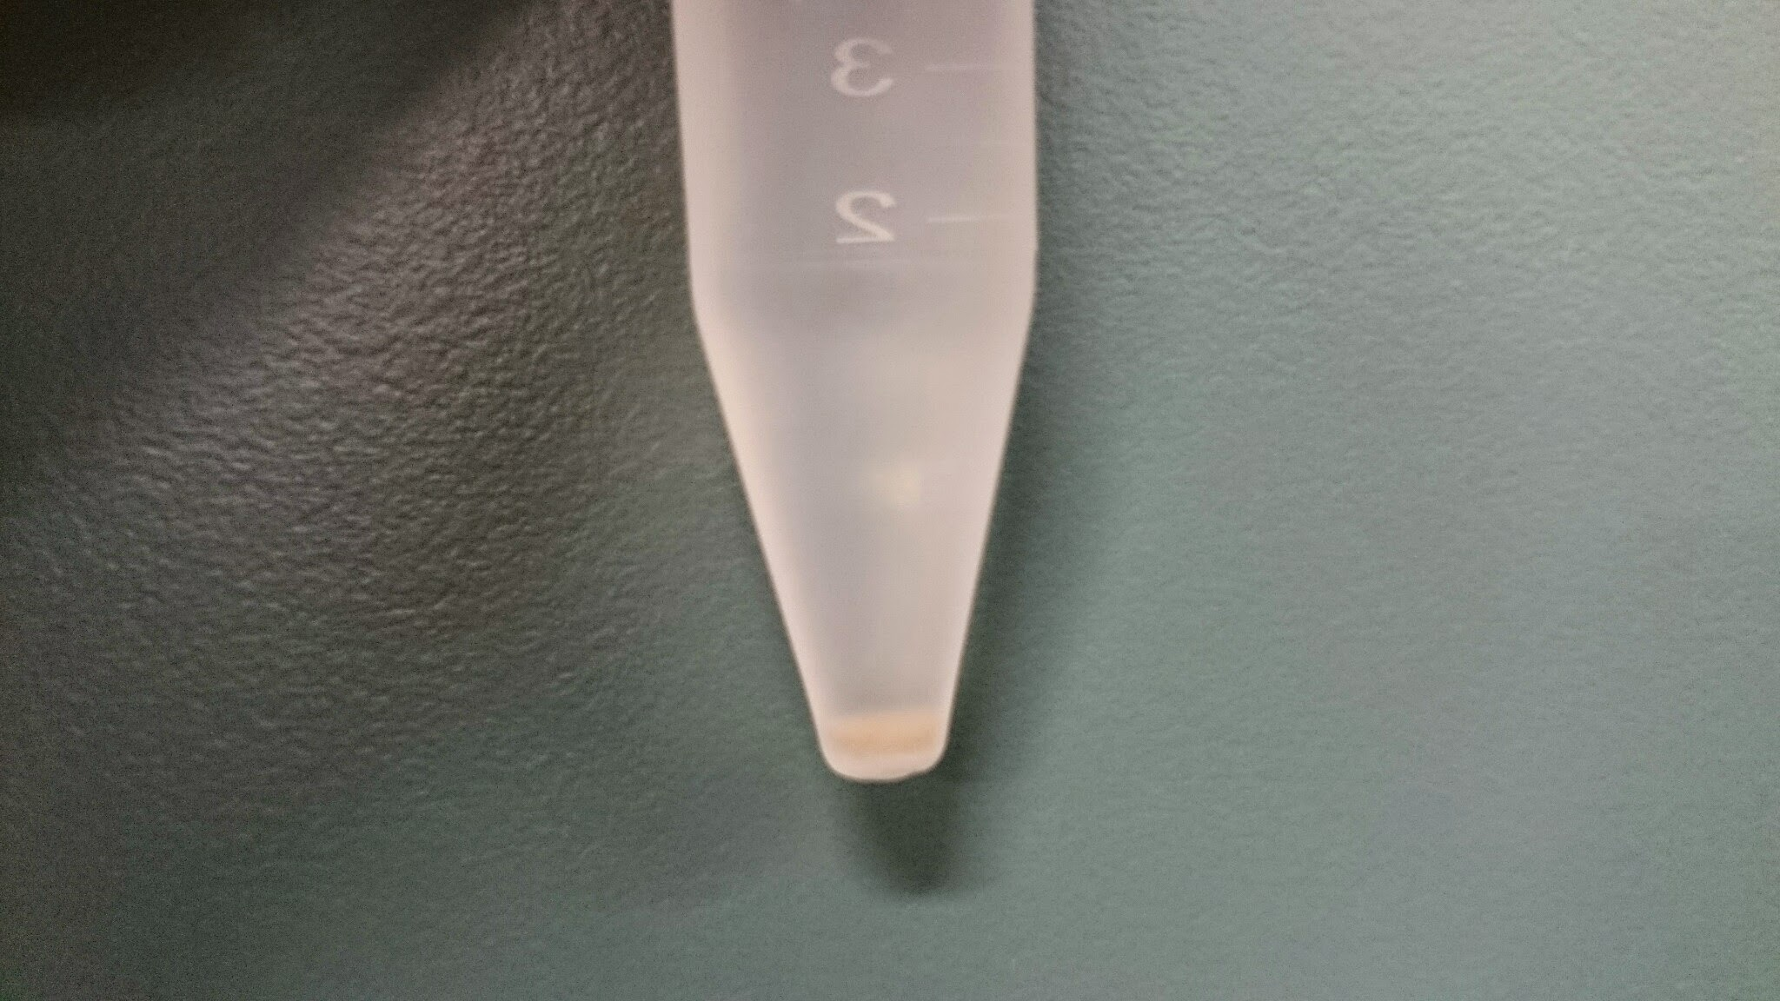
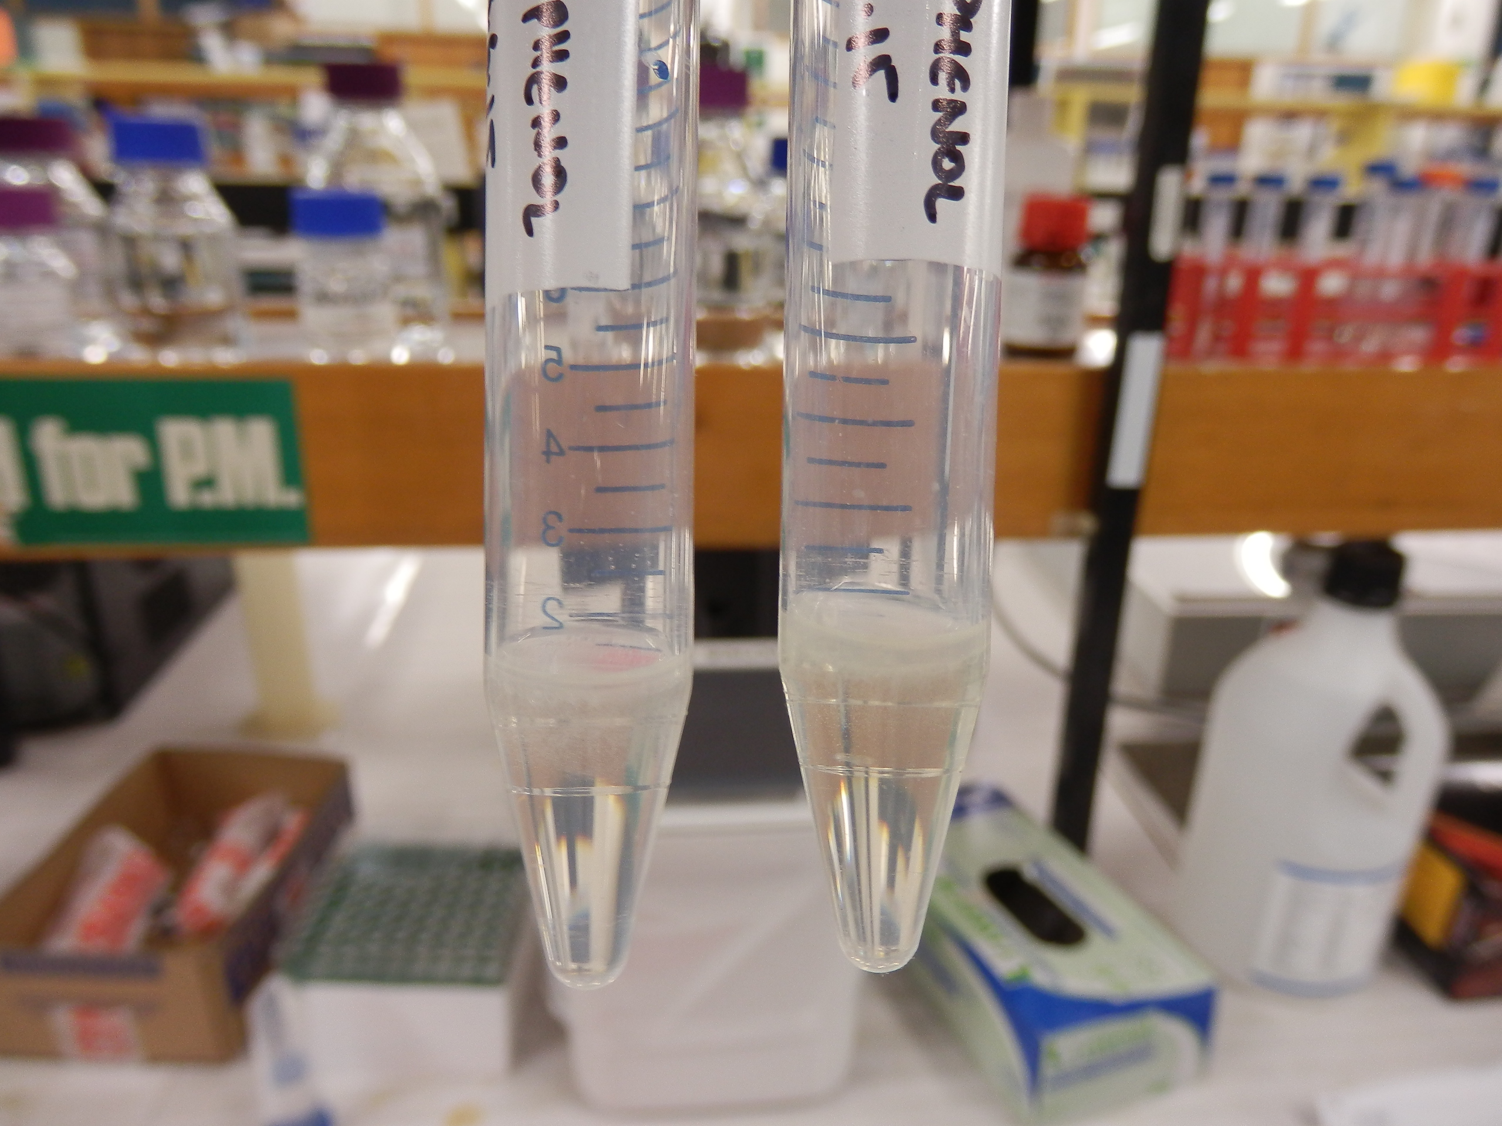
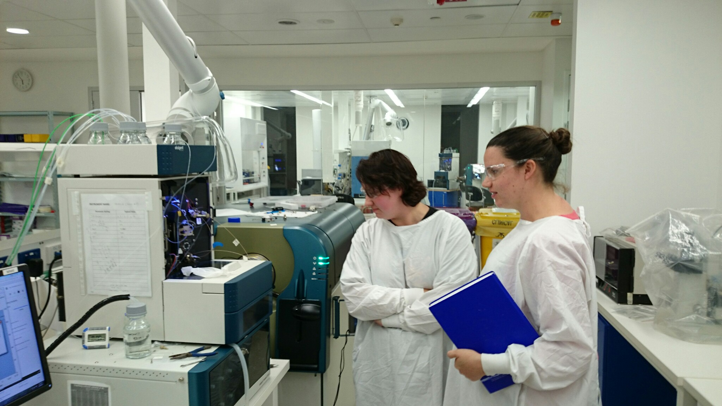
Protein extraction
120,000 MS/MS spectra collected
Liquid chromatography
Mass analyzers separate ions by mass/charge
MS/MS spectra assigned to proteins
Absolute protein quantification:
Relative abundance studies far more common
mg/m² versus unitless relative comparisons
Cross species & cross experiment comparisons possible
Quantitative protein extraction
Internal standards
<500 proteins account for >90% total leaf protein

Slide 8
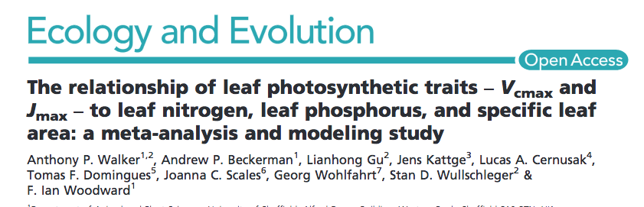
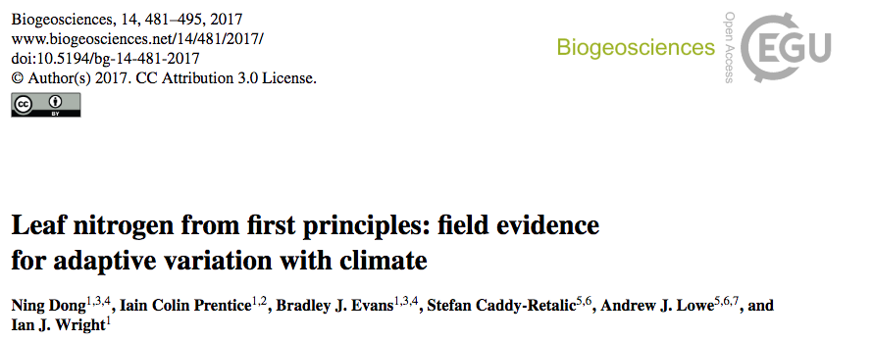
2014
Relationships of Vcmax and Jmax with leaf N, P, and specific leaf area
Predict Vcmax with leaf N and P
Predict N per leaf area (rubisco & structural proteins) based on leaf mass per area and environmental variables
“All models that attempt to represent the coupling between C and N cycles… require a method to calculate leaf N content.”
“Models that assume proporationality between Vcmax and Narea neglect the important variation in leaf structural N.”
Many models predict Vcmax from leaf N, but underestimate N in rubisco because mesophyll conductance is overestimated.
The results is that nitrogen use efficiency is overestimated

Slide 9
Environmental variables, in combination with leaf N, better predict Vcmax and Jmax than leaf N alone.
The implication is that environmental variables affect N allocation to different protein functional categories
LUNA: leaf utilization of nitrogen for assimilation
Predicted Vcmax and Jmax by modelling optimal allocation of leaf N to light capture, electron transport, carboxylation, and respiration

